Slide 1

Topic Clustering Visualization
Brought to you by the Gould Library Data Services

Slide 2
Topic Clustering Visualization

Slide 3
Topic Clustering Visualization
Topic clustering visualization allows us to see the words distribution and how each clusters are related
It is almost important visualize our topic clustering using ggplot2 so we will create a JSON file format for our topic clustering results and use Java script to visualize our results
Here, we will use our source code createChoyJson_v2.R (a source code that changes the clustering results)
We will also need to install/launch Apache Tomcat (for Windows users)

Slide 4
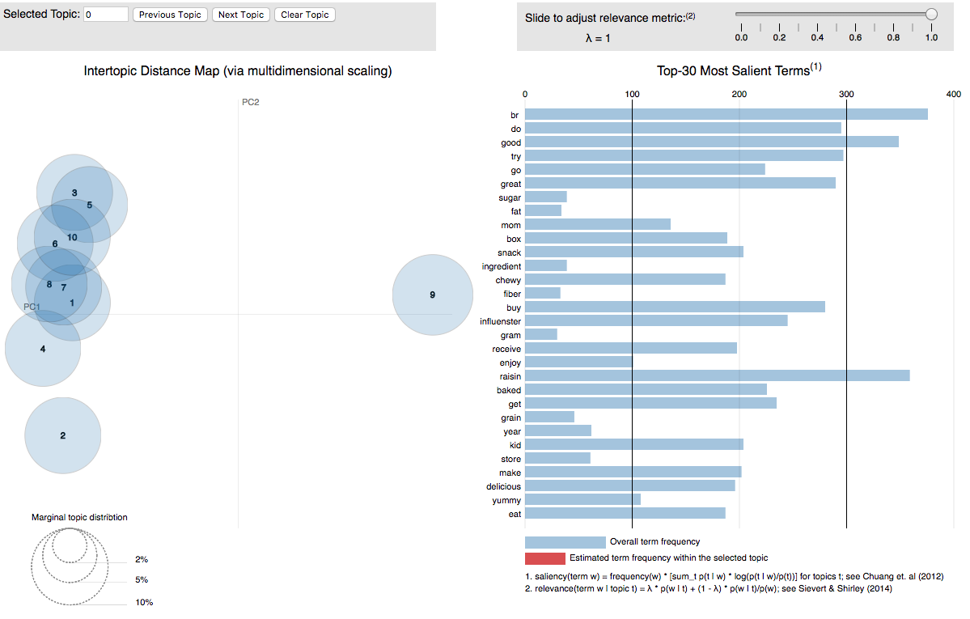
Result

Slide 5
Controlling the Weight of Topic Related Word
Topic Clustering is a useful tool but interpreting topics is a difficult task
Therefore, it is important to look at the ranking of the words in each topics. High ranking does not necessarily mean high word frequency. Instead, it means the high possibility of the occurrences
Based on the formula above, the value of p(w | t) and p(w | t)/p(w)’s influence change based on the value of λ(0~1)

